Slide 1
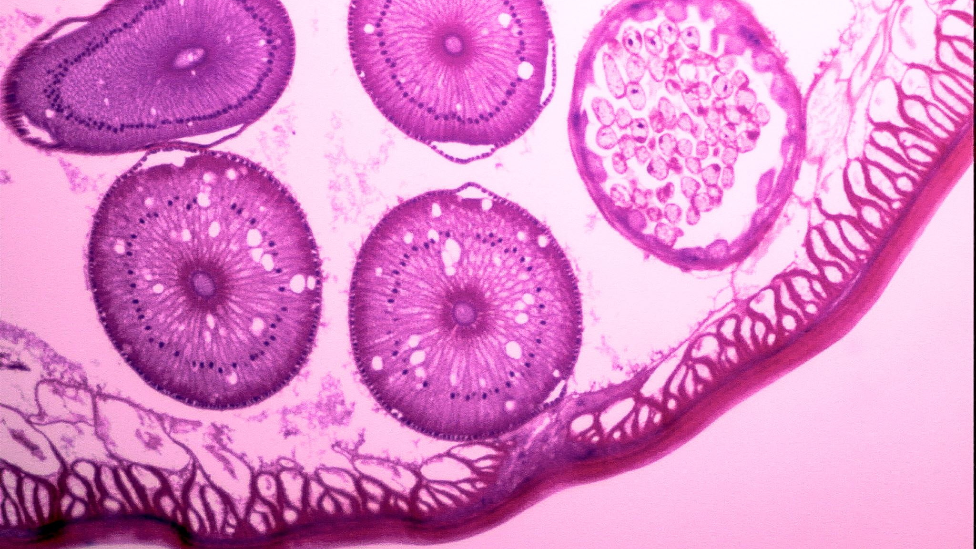
Classification of Optical Coherence Tomography (OCT) Images
Team 1:
Satya Sai Mandlem
Nikitha Guntaka
Hemanth Varma Dantuluri

Slide 2
Do you know?
According to National Library of Medicine, 2.2 Million people^{[4,5,6]} globally are suffering from Vision Impairments, can grow to 5.4 million by 2050
Most cases can be prevented when treated at early stages.

Slide 3
Optical coherence tomography
Optical coherence tomography (OCT)^{[1]} is a non-invasive imaging test. It uses light waves to take cross-section pictures of your retina.
With OCT, your ophthalmologist can see each of the retina’s distinctive layers. This allows your ophthalmologist to map and measure their thickness. These measurements help with diagnosis.

Slide 4
Importance of oct images
According to National Library of Medicine^{[2]}, drusen, choroidal neovascularization (CNV), and diabetic macular edema (DME) are significant causes of visual impairment globally. Optical coherence tomography (OCT) imaging has emerged as a valuable diagnostic tool for these ocular conditions. However, subjective interpretation and inter-observer variability highlight the need for standardized diagnostic approaches.

Slide 5
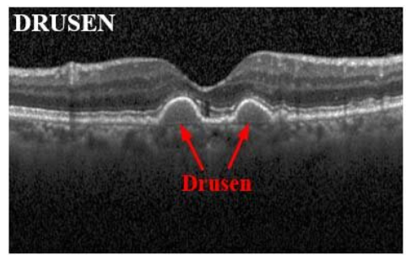
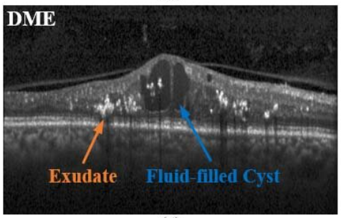
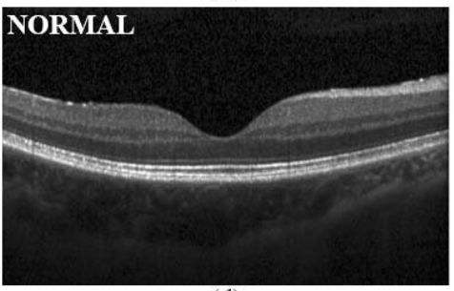
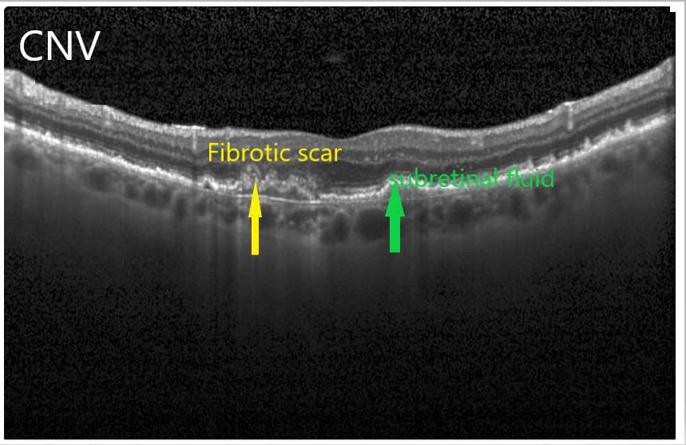
In-depth classification of each condition:

Slide 6
objectives
Develop deep learning models capable of accurately classifying retinal diseases such as CNV, DME, and Drusen based on OCT images.
Evaluate the effectiveness of various deep learning architectures for OCT image classification.
Investigate the impact of dataset size and diversity on model performance and generalization ability.
Address class imbalance issues in the dataset, particularly for rare or underrepresented retinal diseases.
Assess the influence of preprocessing techniques on model performance and interpretability.

Slide 7
Our research questions
How effective are deep learning models in accurately classifying retinal diseases based on OCT images?
Which deep learning architectures prove most effective for OCT image classification?
How does the size and diversity of the training dataset impact model robustness and generalization ability?
What strategies can be employed to address class imbalance issues in the OCT image dataset?
How do preprocessing techniques such as denoising, image registration, and normalization impact model performance and interpretability?

Slide 8
About the dataset
Source:
Kermany, Daniel; Zhang, Kang; Goldbaum, Michael (2018), “Labeled Optical Coherence Tomography (OCT) and Chest X-Ray Images for Classification”, Mendeley Data, V2, doi: 10.17632/rscbjbr9sj.2^{[3]}
The dataset has 62,138 images of the following classes,
CNV (Choroidal Neovascularization) – 15109 images
DME (Diabetic Macular Edema) – 11598 images
DRUSEN – 8866 images
NORMAL – 26565 images

Slide 9
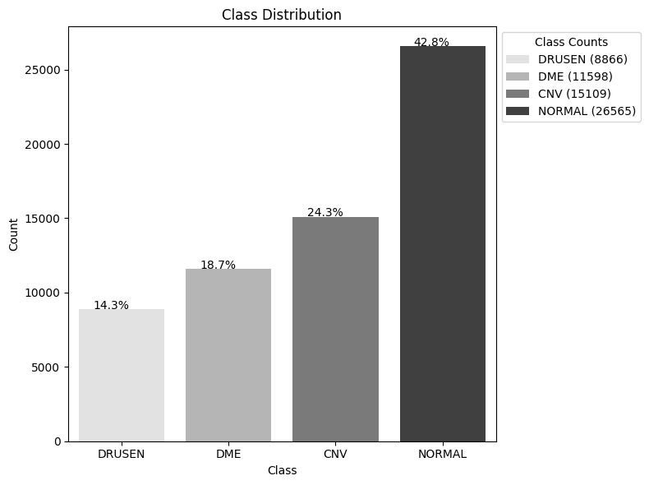

Slide 10
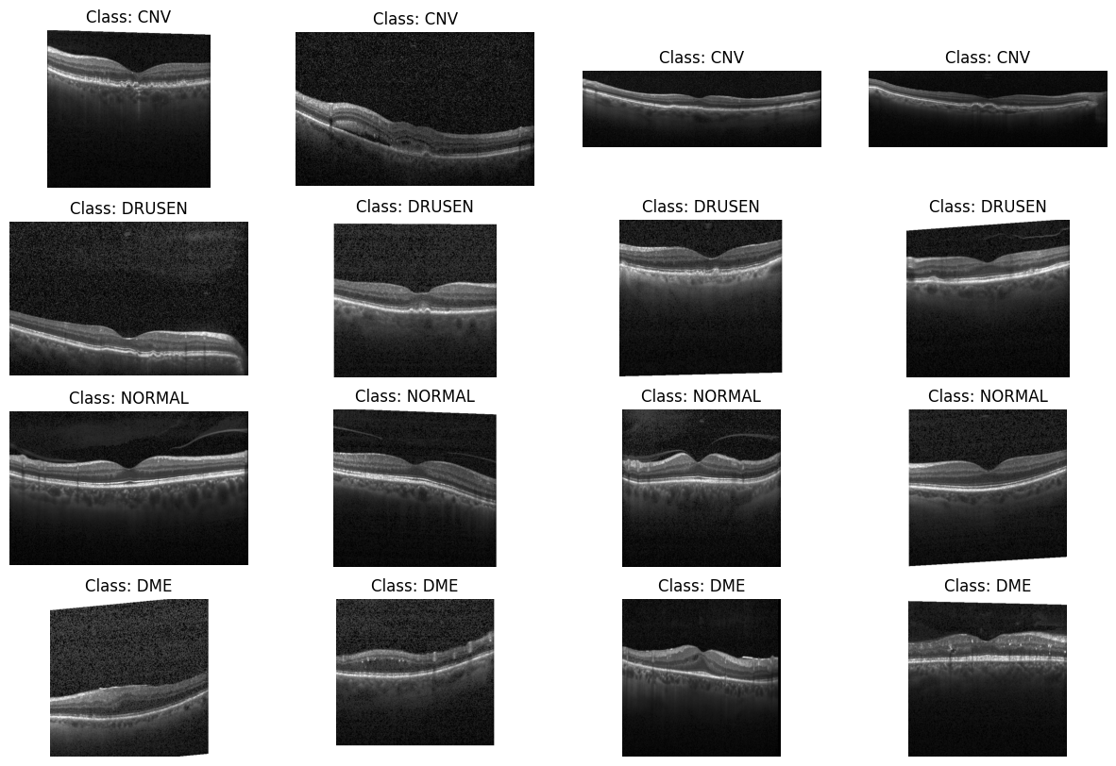
Sample images

Slide 11
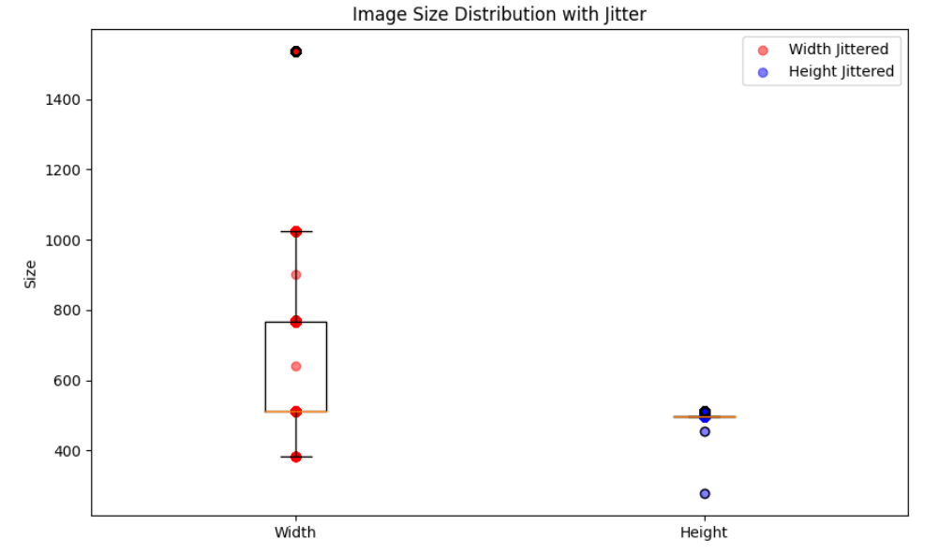
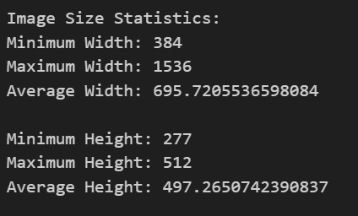

Slide 12
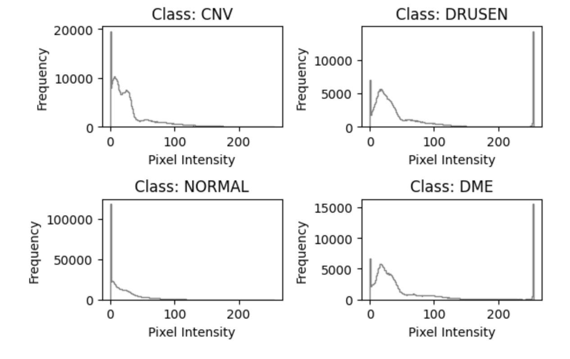

Slide 13
Preprocessing steps
We resized the images to 256x256 and normalized the pixels using OpenCV library.
We then stored the images in NumPy arrays and performed augumentation.
We used data augmentation setup with Keras' ImageDataGenerator, which will generate augmented versions of the original images on-the-fly during training. Each batch of images fed into the model for training will be augmented differently, introducing variability and helping the model generalize better.

Slide 14
Modelling

Slide 15
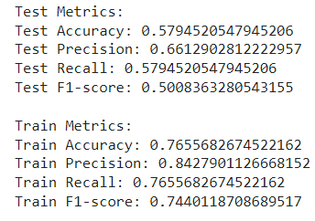
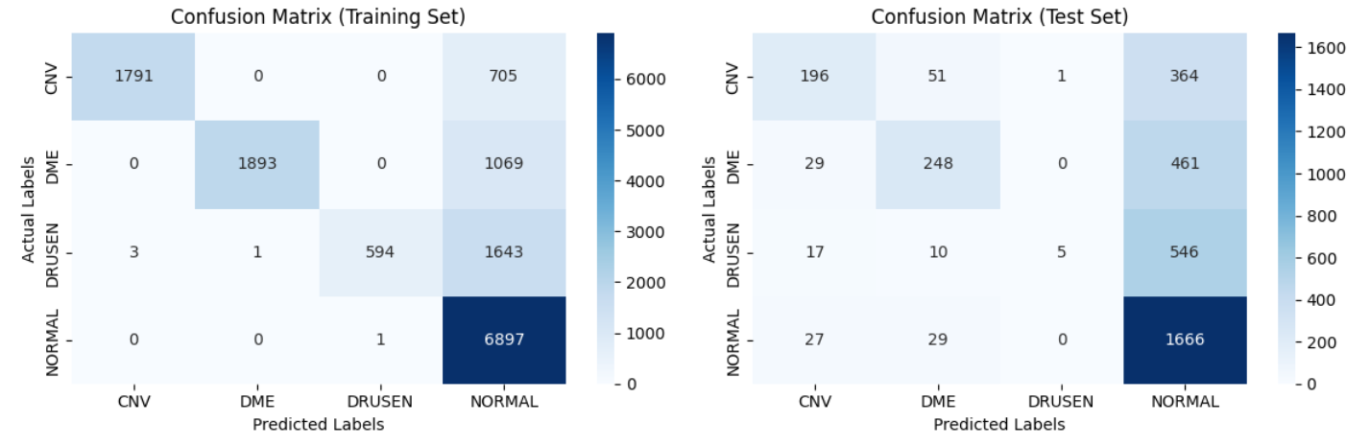
Random Forest
n_estimators=20
max_depth = 10
max_features= "sqrt“

Slide 16
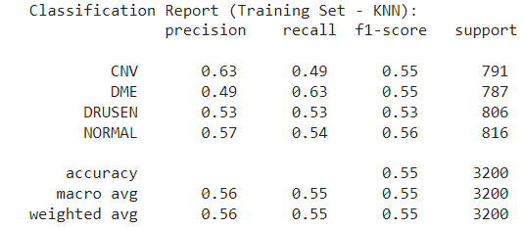
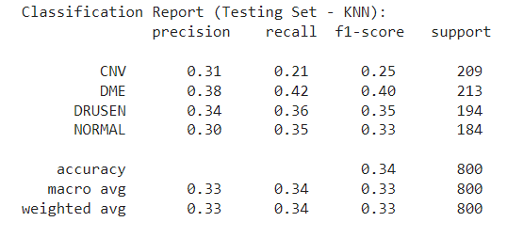
K-Nearest Neighbors (KNN)
algorithm='auto’
n_neighbors= 7
p= 1

Slide 17
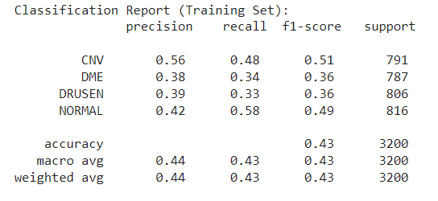
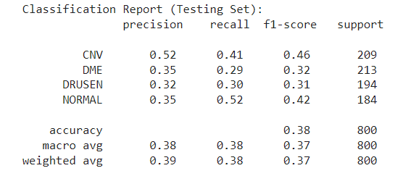
Support Vector Machines (SVM)
gamma='auto’
C= 1
kernel = 'rbf

Slide 18
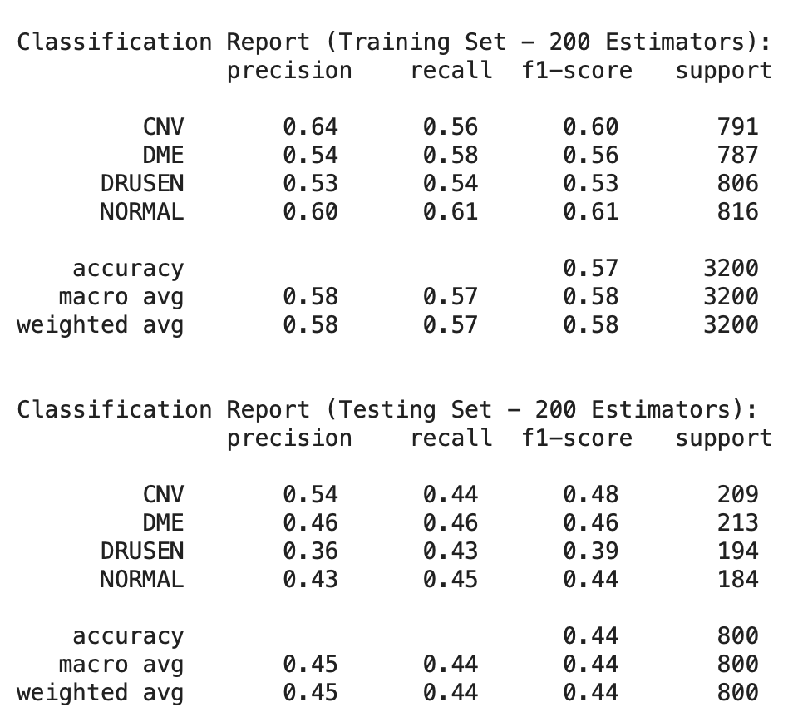
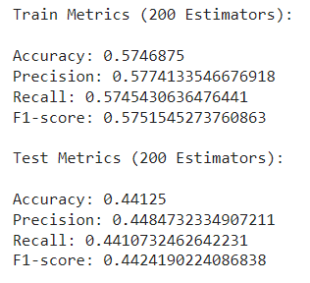
Adaboosting
n_estimators=200
learning_rate=0.1

Slide 19
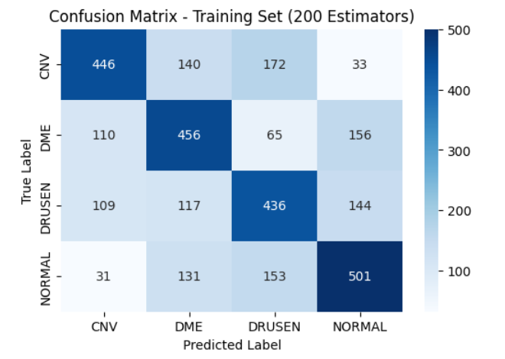
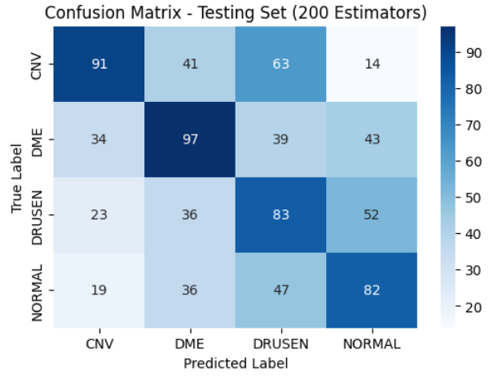

Slide 20
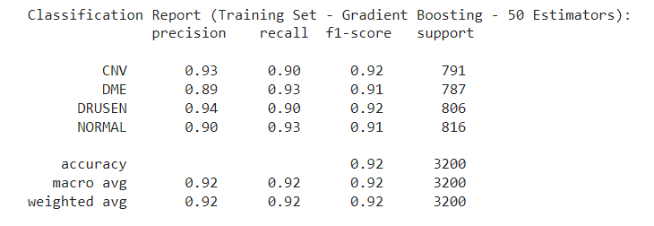
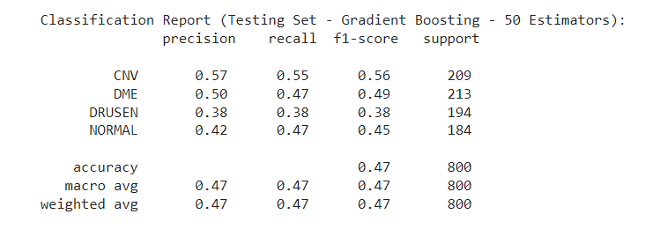
GradientBoosting
n_estimators=50
learning_rate=0.1

Slide 21
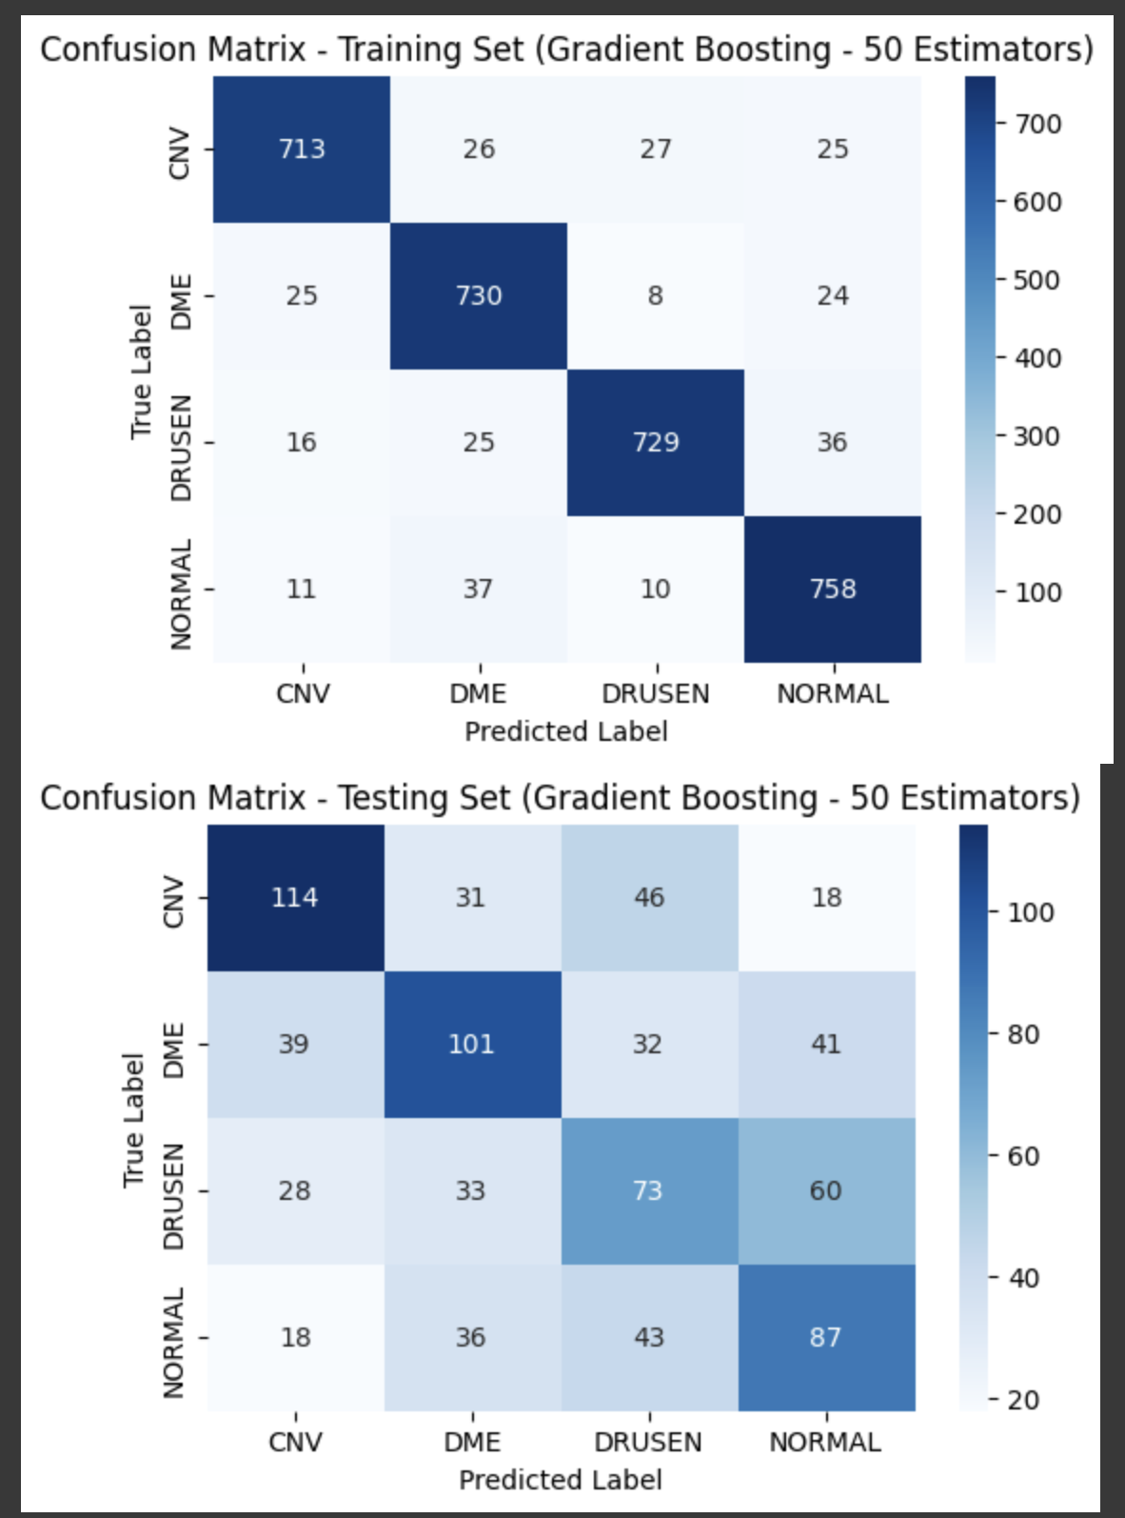
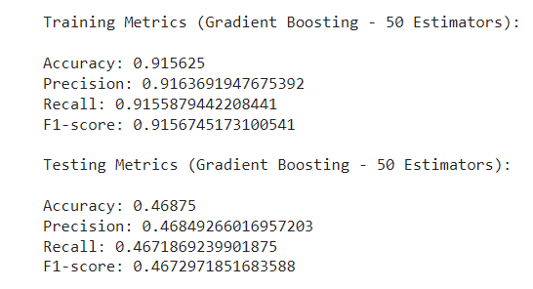

Slide 22
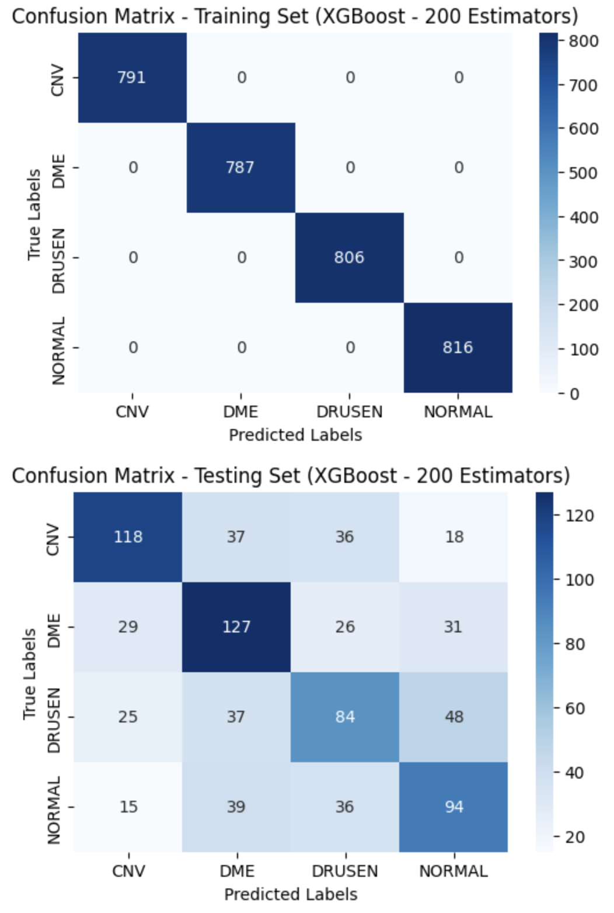
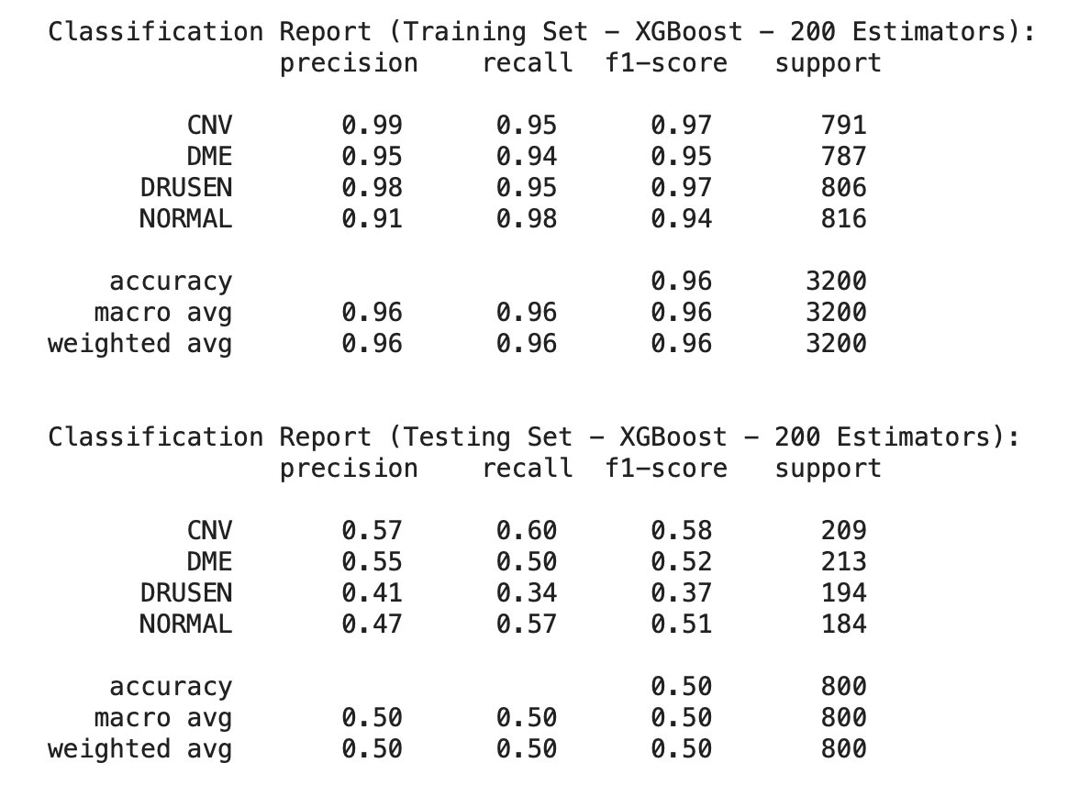
Xgboosting:
n_estimators=200, learning_rate=0.01, max_depth = 5)

Slide 23
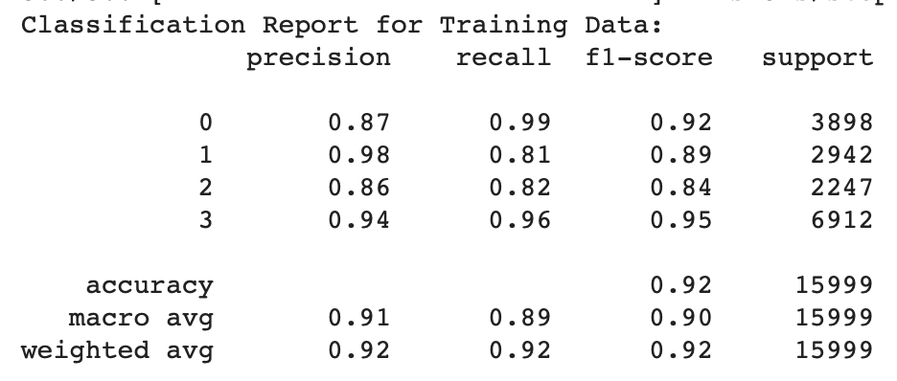
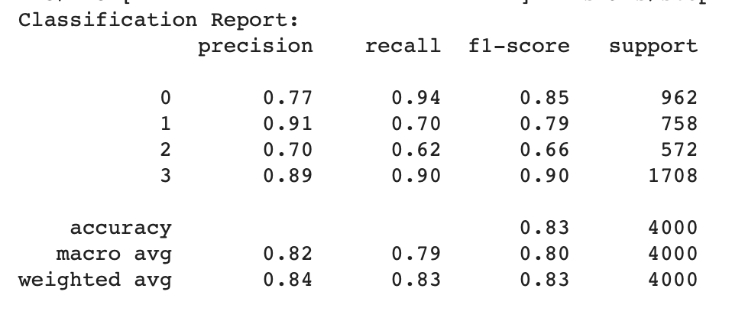
VGG-16
optimizer=Adam(lr=0.001),
loss='sparse_categorical_crossentropy'

Slide 24
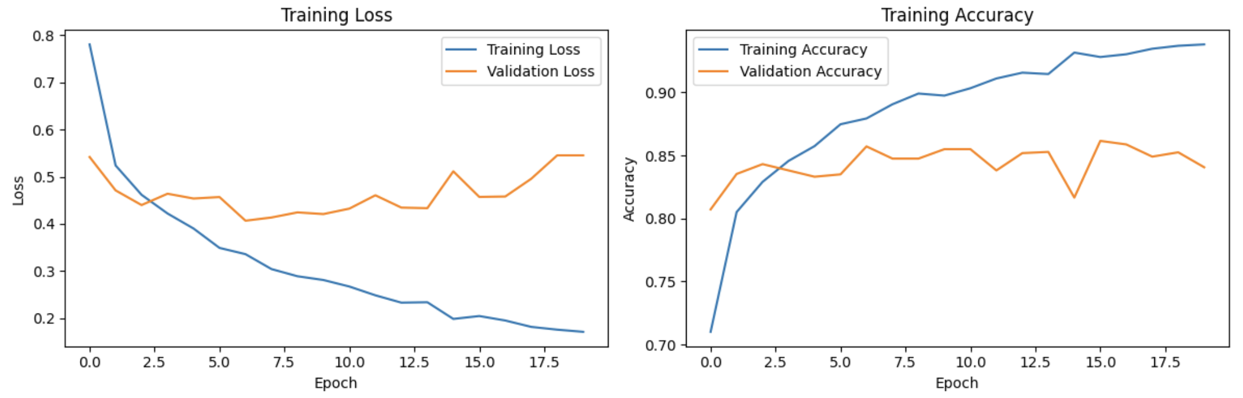

Slide 25
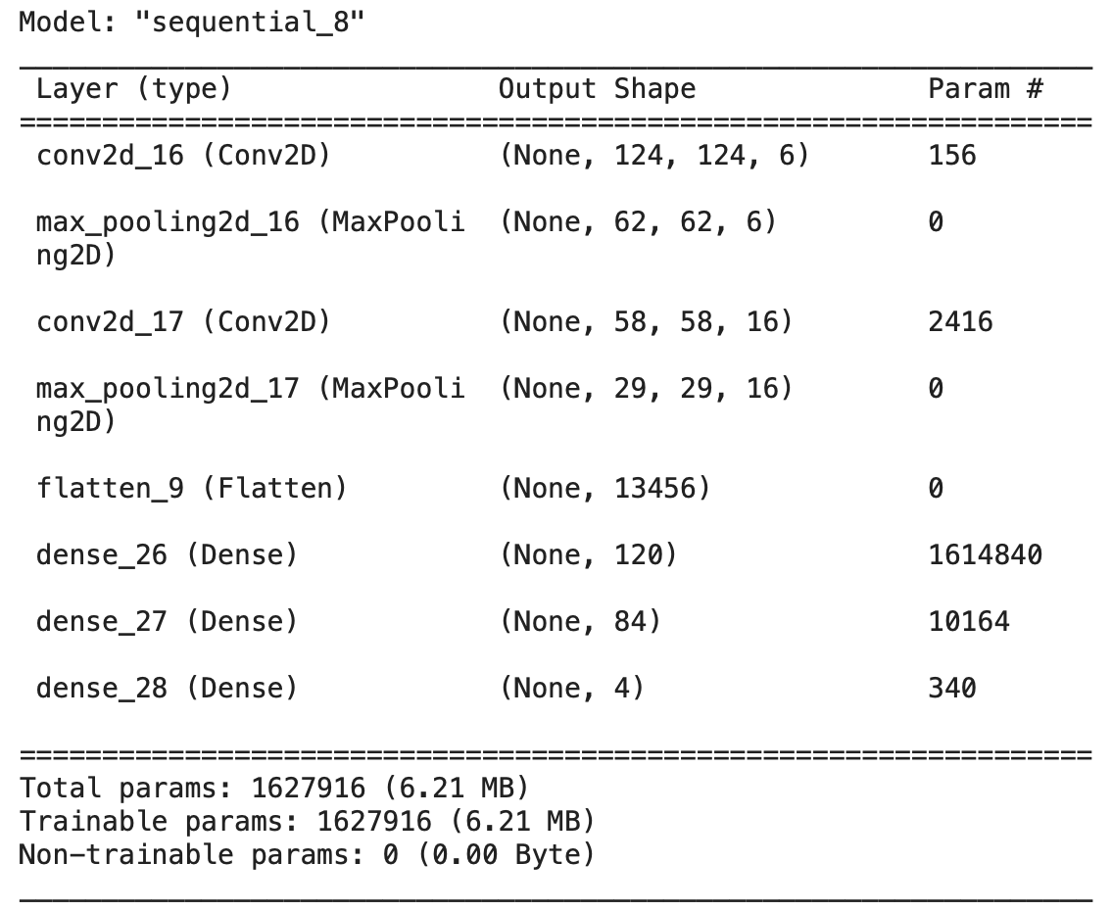
Le-Net Model
optimizer='adam',
loss='sparse_categorical_crossentropy'

Slide 26
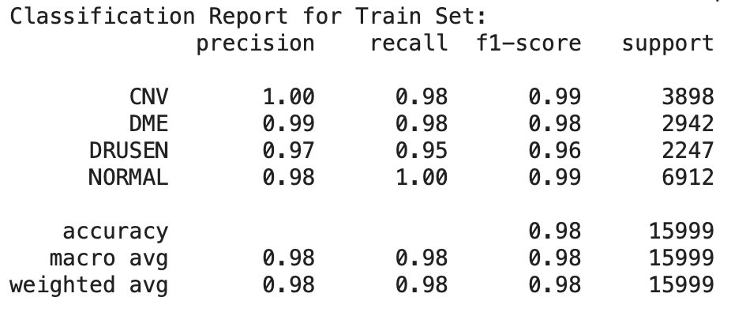
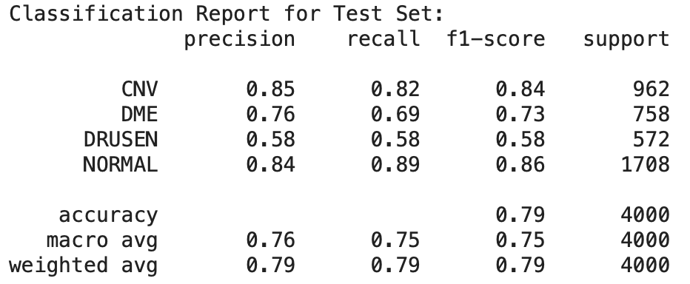
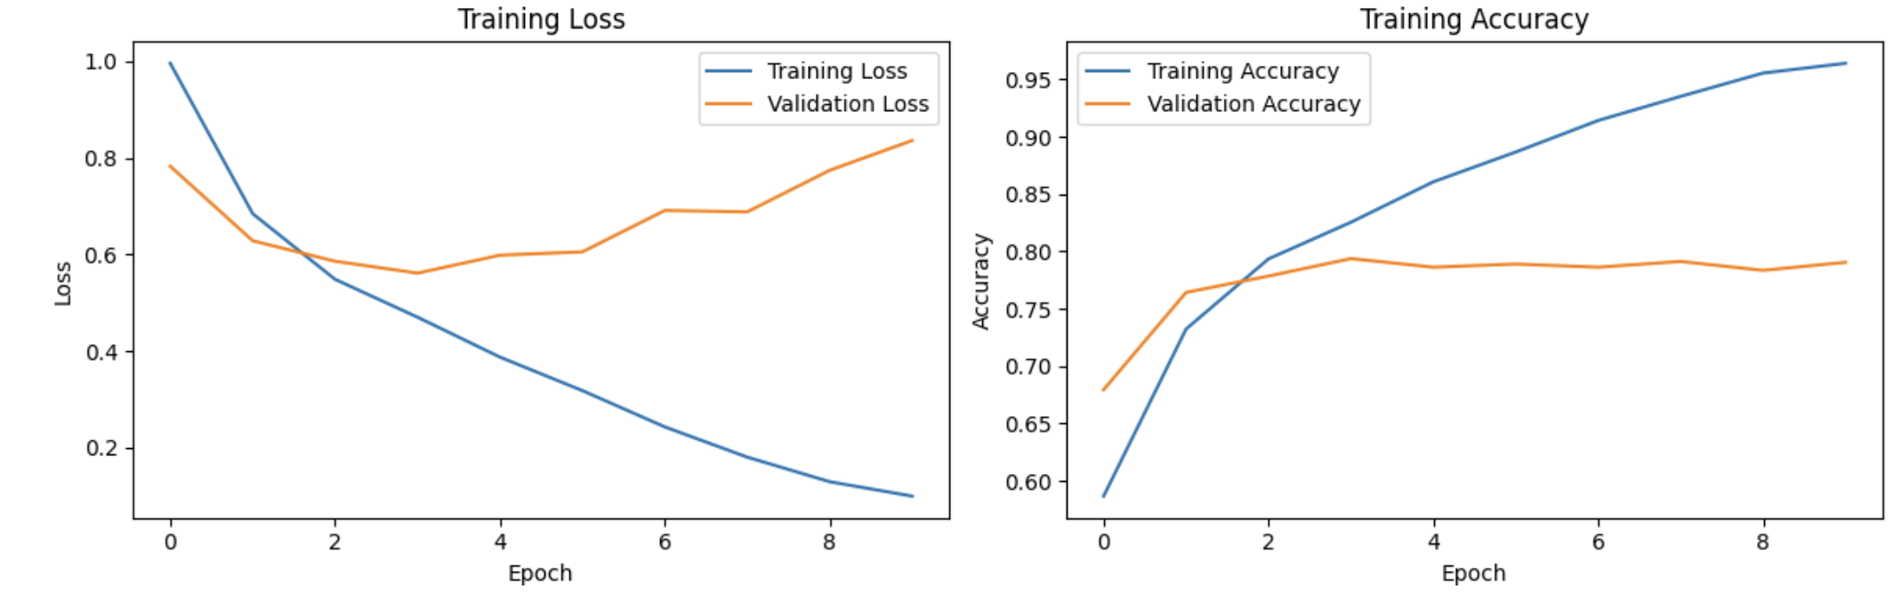

Slide 27
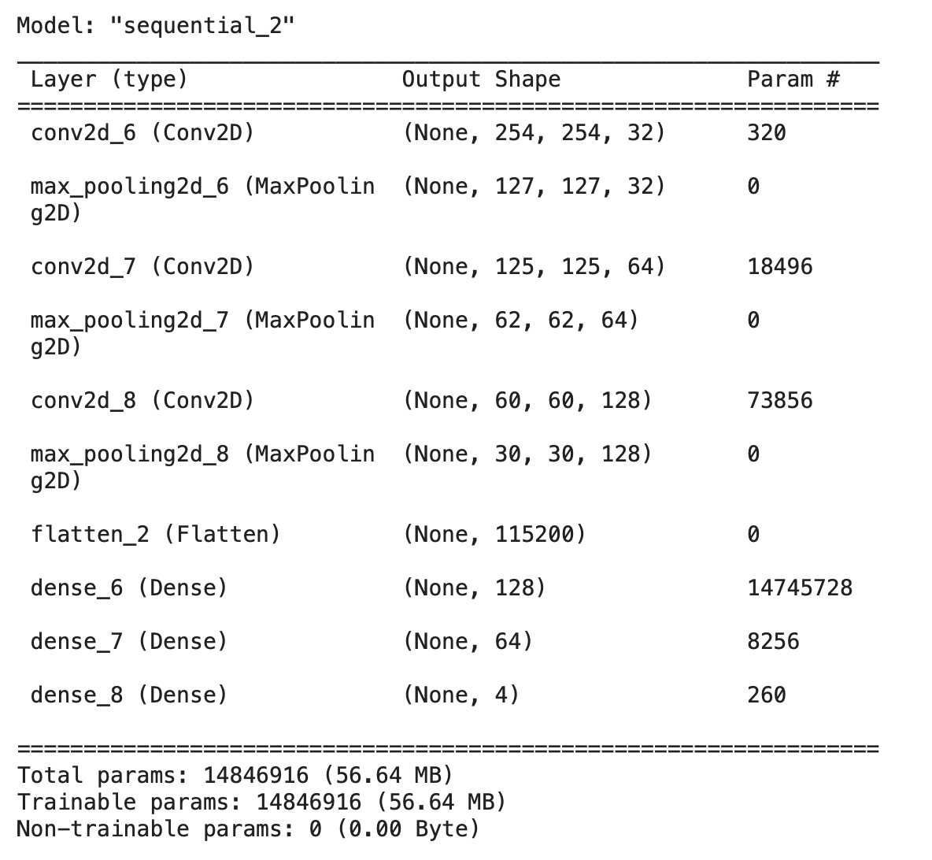
Convolution neural networks
3 Convolutional layers (conv2d)
3 Pooling layers (max_pooling2d)
1 Flatten layer
3 Dense layers (dense)

Slide 28
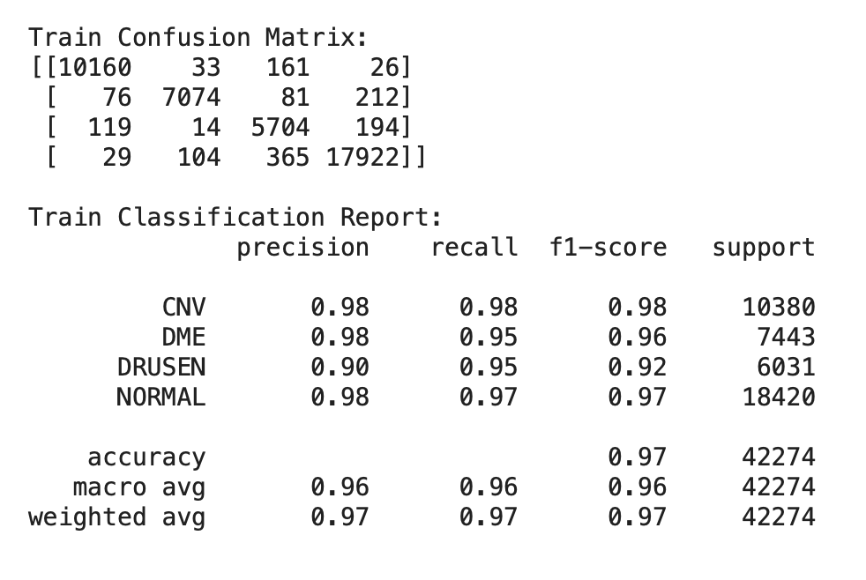
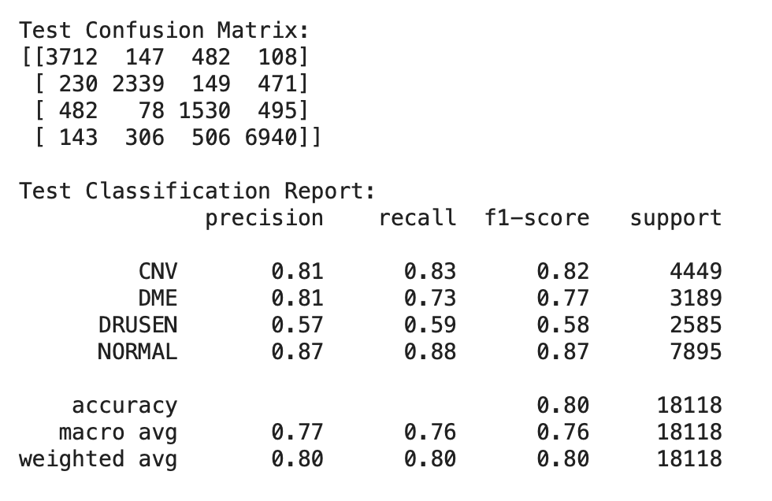
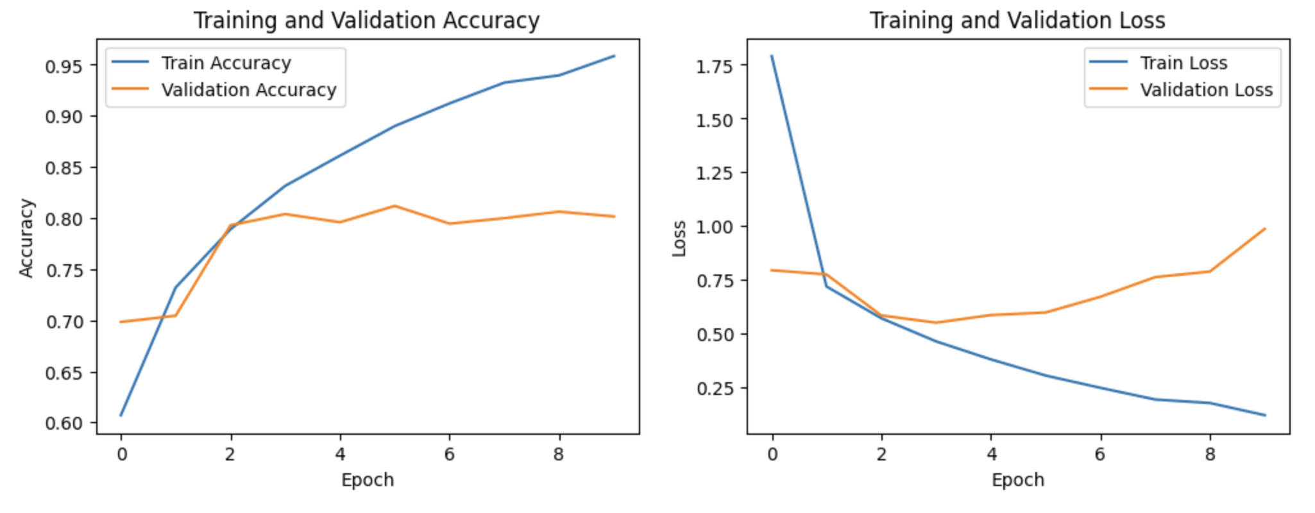

Slide 29
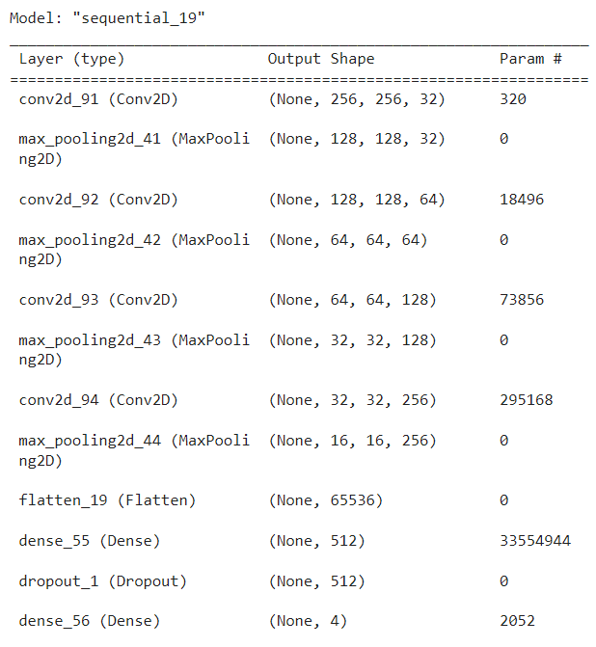
Convolution Neural networks
4 Convolutional layers (conv2d)
4 Pooling layers (max_pooling2d)
1 Flatten layer
3 Dense layers (dense)
Shape of X_train: (42274, 256, 256)
Shape of y_train: (42274,)
Shape of X_test: (18118, 256, 256)
Shape of y_test: (18118,)

Slide 30
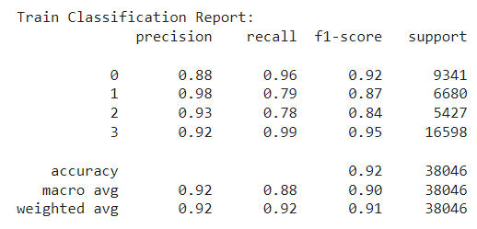
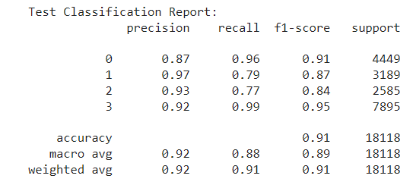
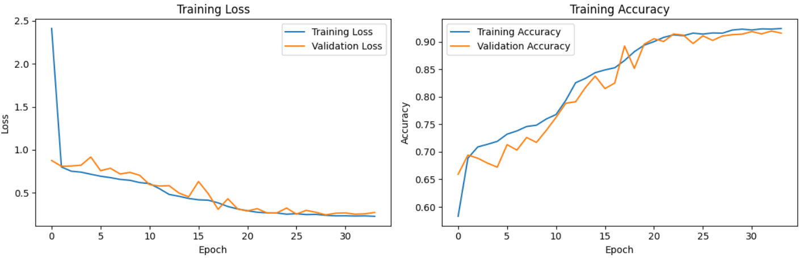

Slide 31
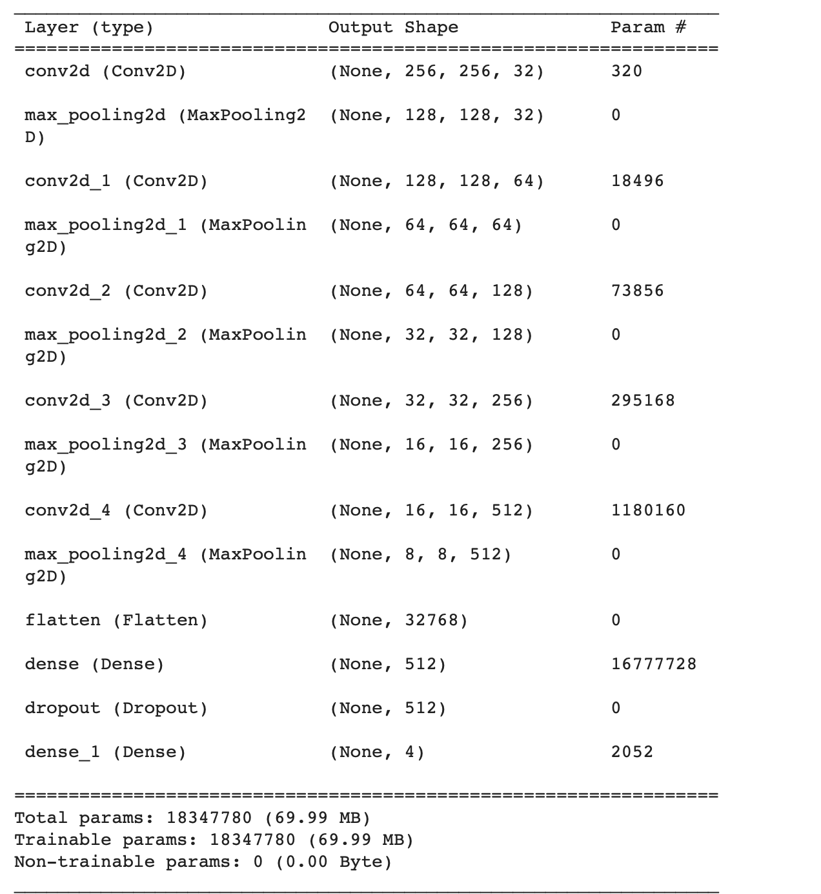
Best performing model- cnn
5 Convolutional layers (conv2d).
5 Pooling layers (max_pooling2d).
1 Flatten layer.
2 Dense layers (dense, dense_1)
1Dropout layer

Slide 32
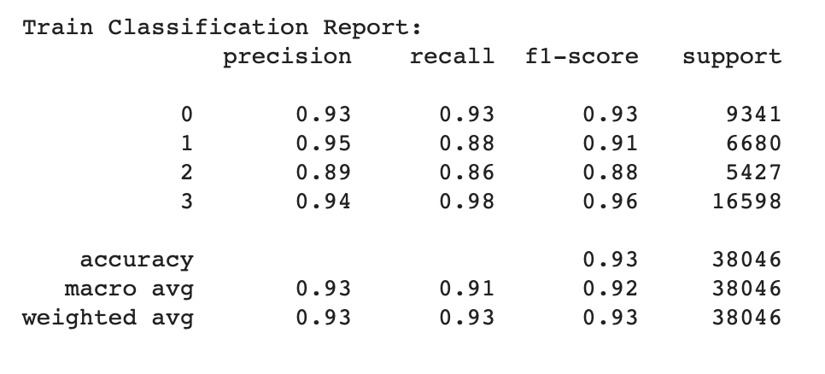
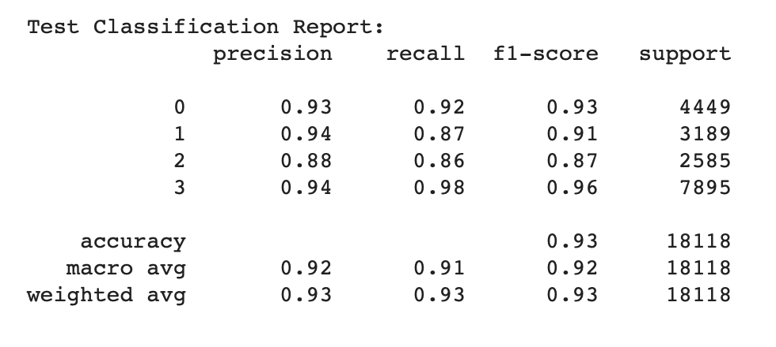
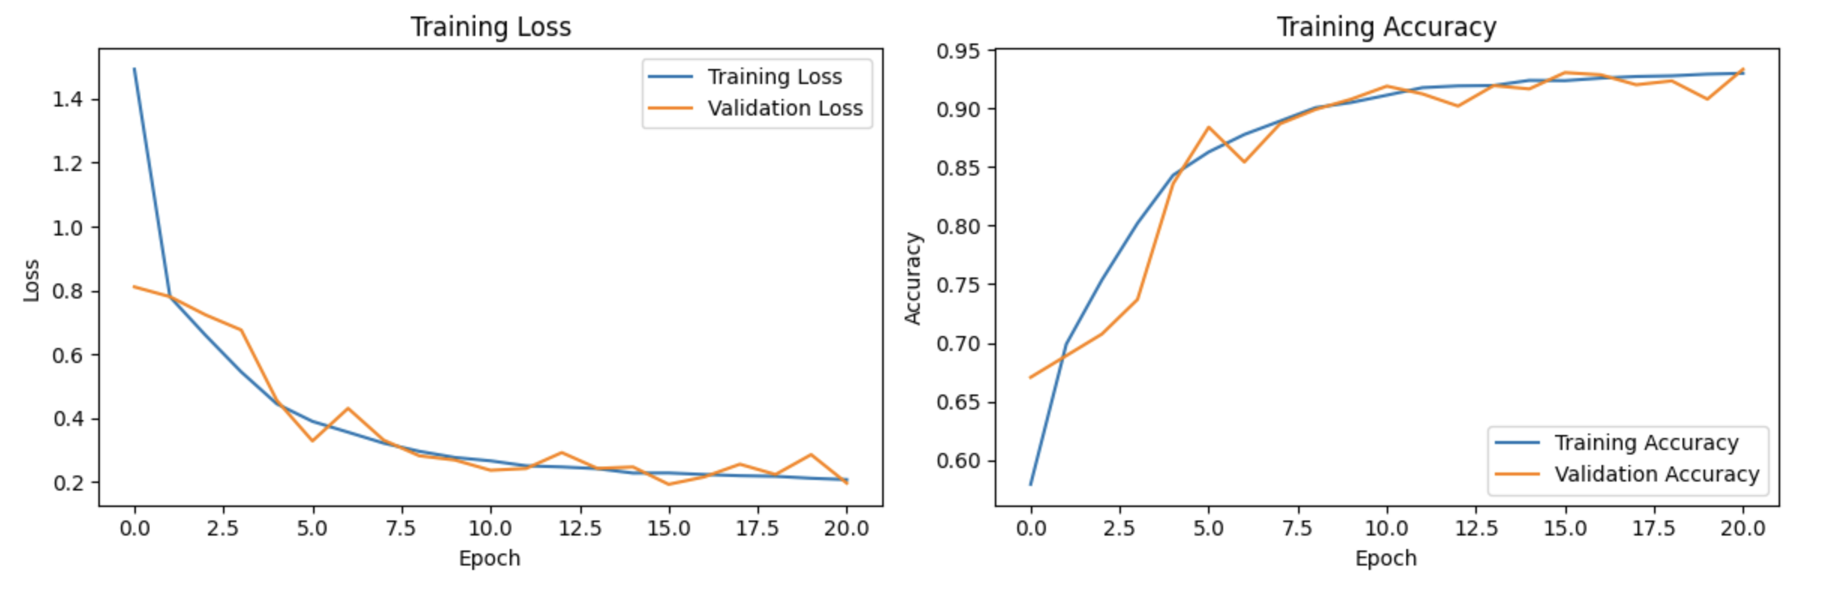

Slide 33
 | CNV | DME | DRUSEN | NORMAL | Overall F-1 Score
XGBoosting (n_estimators=200, learning_rate=0.01, max_depth = 5) |  |  |  |  |  | Number of images = 20,000
Train | 0.97 | 0.95 | 0.97 | 0.94 | 0.95
Test | 0.58 | 0.52 | 0.37 | 0.51 | 0.5
Gradient Boosting (n_estimators=50, learning_rate=0.1)
Train | 0.92 | 0.91 | 0.92 | 0.91 | 0.91
Test | 0.56 | 0.49 | 0.38 | 0.45 | 0.46
AdaBoosting (n_estimators=200,learning_rate=0.1)
Train | 0.6 | 0.56 | 0.53 | 0.61 | 0.57
Test | 0.48 | 0.46 | 0.39 | 0.44 | 0.44
K-Nearest Neighbors (n_neigbors=7, p=1)
Train | 0.55 | 0.55 | 0.53 | 0.56 | 0.54
Test | 0.25 | 0.4 | 0.35 | 0.33 | 0.33
VGG16 (optimizer=Adam( lr =0.001), loss='sparse categorical cross-entropy')
Train | 0.92 | 0.89 | 0.84 | 0.95 | 0.9
Test | 0.85 | 0.79 | 0.66 | 0.9 | 0.8
LeNet (optimizer='adam', loss='sparse categorical cross-entropy')
Train | 0.99 | 0.98 | 0.96 | 0.99 | 0.98
Test | 0.82 | 0.69 | 0.58 | 0.86 | 0.73
CNN ( 3 Convolutional layers (conv2d), 3 Pooling layers (max_pooling2d), 1 Flatten layer, 3 Dense layers (dense)) |  |  |  |  |  | Number of images = 62,138 (Entire Dataset)
Train | 0.98 | 0.96 | 0.92 | 0.97 | 0.95
Test | 0.82 | 0.77 | 0.58 | 0.87 | 0.76
CNN ( 5 Convolutional layers (conv2d), 5 Pooling layers (max_pooling2d), 1 Flatten layer, 2 Dense layers (dense, dense_1), 1Dropout layer)
Train | 0.93 | 0.91 | 0.88 | 0.96 | 0.92
Test | 0.93 | 0.91 | 0.87 | 0.96 | 0.92

Slide 34
Addressing Our research questions
How effective are deep learning models in accurately classifying retinal diseases based on OCT images?
Which deep learning architectures prove most effective for OCT image classification?
How does the size and diversity of the training dataset impact model robustness and generalization ability?
What strategies can be employed to address class imbalance issues in the OCT image dataset?
How do preprocessing techniques such as denoising, image registration, and normalization impact model performance and interpretability?

Slide 35
References
Turbert, D. (2023, April 27). What is optical coherence tomography?. American Academy of Ophthalmology. https://www.aao.org/eye-health/treatments/what-is-optical-coherence-tomography
Riazi Esfahani, P., Reddy, A. J., Nawathey, N., Ghauri, M. S., Min, M., Wagh, H., Tak, N., & Patel, R. (2023, July 9). Deep Learning Classification of drusen, choroidal neovascularization, and diabetic macular edema in Optical Coherence Tomography (OCT) images. Cureus. https://www.ncbi.nlm.nih.gov/pmc/articles/PMC10411652/#:~:text=Age%2Drelated%20macular%20degeneration%20(AMD,tool%20for%20these%20ocular%20conditions
Kermany, D. (2018, January 6). Labeled optical coherence tomography (OCT) and chest X-ray images for classification. Mendeley Data. https://data.mendeley.com/datasets/rscbjbr9sj/2
Sharif, Z., & Sharif, W. (2019). Corneal neovascularization: Updates on pathophysiology, Investigations & Management. Romanian journal of ophthalmology. https://www.ncbi.nlm.nih.gov/pmc/articles/PMC6531773/
Yau, J. W. Y., Rogers, S. L., Kawasaki, R., Lamoureux, E. L., Kowalski, J. W., Bek, T., Chen, S.-J., Dekker, J. M., Fletcher, A., Grauslund, J., Haffner, S., Hamman, R. F., Ikram, M. K., Kayama, T., Klein, B. E. K., Klein, R., Krishnaiah, S., Mayurasakorn, K., O&rsquo;Hare, J. P., … Wong, T. Y. (2012, February 10). Global prevalence and major risk factors of diabetic retinopathy. American Diabetes Association. https://diabetesjournals.org/care/article/35/3/556/28568/Global-Prevalence-and-Major-Risk-Factors-of
Johnson, P. T., Lewis, G. P., Talaga, K. C., Brown, M. N., Kappel, P. J., Fisher, S. K., Anderson, D. H., & Johnson, L. V. (2003, October 1). Drusen-associated degeneration in the retina. Investigative Ophthalmology & Visual Science. https://iovs.arvojournals.org/article.aspx?articleid=2182253

